Slide 1
Tackling a Wicked Problem FA19
“Day-to-Day Democracy”
an experiment in utopian pedagogy

Slide 2
Day-to-Day Democracy: inspiration
“The crucial matter at hand is how to appropriate, invent, direct, and control the multiple layers of power and politics that constitute both the institutional formation of education and the pedagogies, which are often outcomes of deliberate struggles to establish particular notions of knowledge values and identity…. “
“As committed educators, we cannot eliminate politics, but we can work against a politics of certainty, a pedagogy of censorship, and institutional forms that close down rather than open up democratic relations”
Giroux 2007 in:
Utopian Pedogogies: Radical Experiments against Neoliberal Globalization)

Slide 3
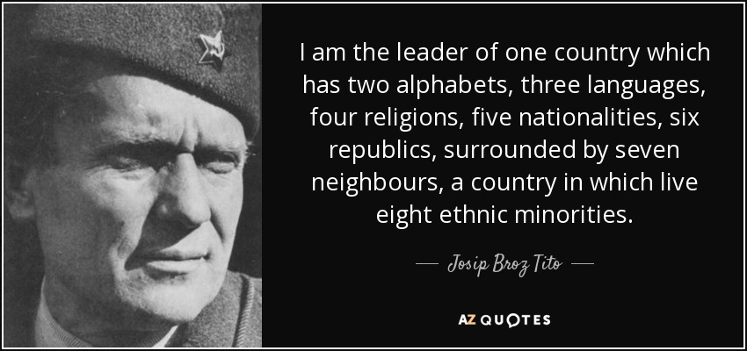
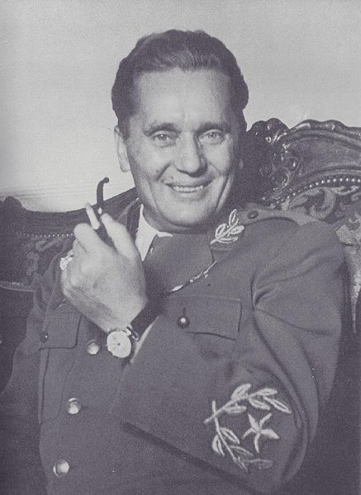
About my section
First developed as First Year Seminar on “Utopian Thinking” (on leave FA17 taught SP18)
Re-volunteered because I like doing it
New Wicked Problem was “Inequality” but utopian thinking as a subtext
I love getting teaching advice but detest any forced structure (personal background)
I resist the mandate to be practical (but I do it)
I reject the commodification of education; degree as a product; corporatization;
I seek an anarchist classroom but settle for a benevolent dictatorship

Slide 4
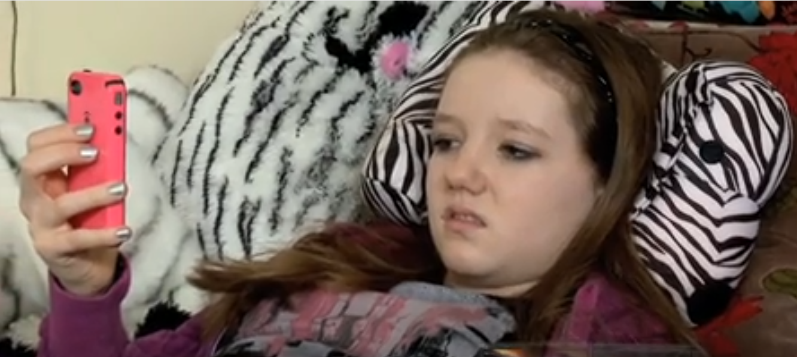
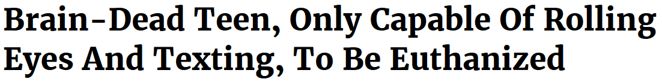
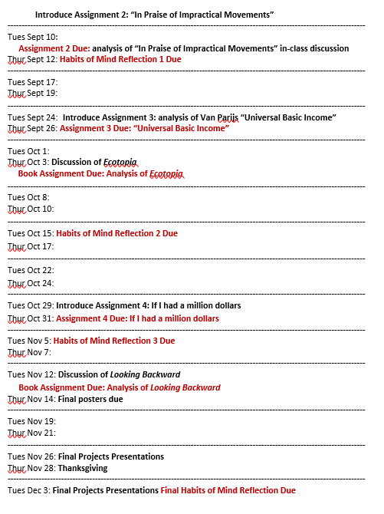
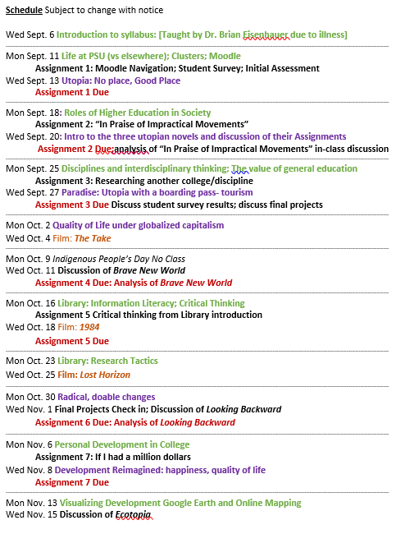
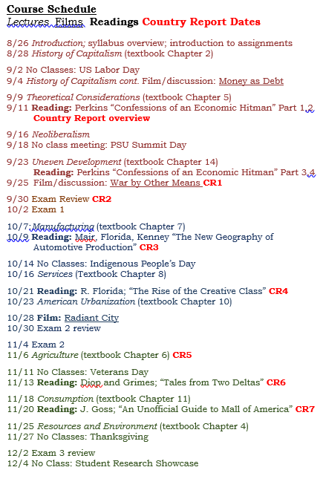
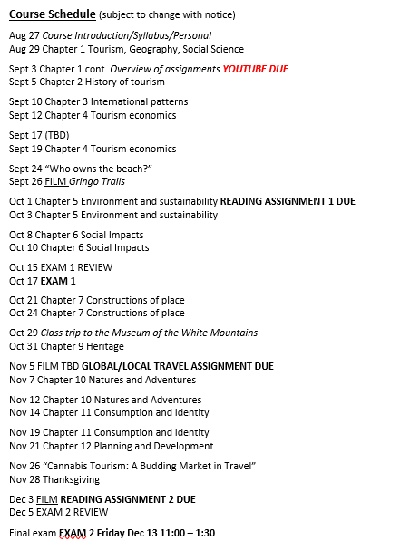
Day-to-Day Democracy: A history
The night before school started
Had researched making it better, memorable
Tired of ‘too cool for school’
Wanted the course to ACTUALLY meet their needs
Needed a radical change
Course was focused on big ideas, big changes
ALL TBD

Slide 5
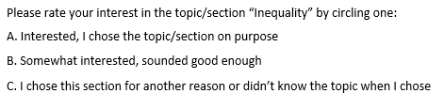
First: Determine if they actually are interested
23/27 were A or B
Second: Let them know what we MUST do:
Things we need to do in class
“Intro to College” Lectures:
Life at PSU (vs elsewhere) Clusters
Roles of Higher Education in Society
Disciplines and interdisciplinary thinking; The value of general education
Interdisciplinary thinking activity on “the lawn”
Inequality Lectures:
Uneven Development: the root of inequality: Bridgeport to Bangkok
Development Reimagined: happiness, quality of life
Utopias in our backyard: NE Intentional Communities and the “Back to the Land” movement
Utopia: No place, Good Place
Privatization and Public Spaces

Slide 6
Third: Brainstorm other options
Things we can choose to do in class:
Film: The Take
Film: The Coconut Revolution
Film: Idiocracy
Film: The Greatest Good: National Forests
Activity: Music time!
Activity: Go on a walk
Activity: Read Ecotopia
Activity: Read Looking Backward
Activity: Sit outside
Activity: Campus picture quest
Activity: Work in the library
Activity: Organize your lives/schedule
Activity: Work on homework/study for other classes
Fourth: come up with democratic mechanism…

Slide 7
You will receive two small pieces of paper.
On the green one, write only your letter choice for today’s discussion.
On the yellow one, clearly write your first and last name, and today’s date.
A: Life at PSU (vs elsewhere): funding, finance, Clusters
B: Roles of Higher Education in Society: how universities work, NCAA
C: Utopia: No place, Good Place: Imagining perfect or better worlds
D: Uneven Development: the root of inequality: Bridgeport to Bangkok
E: It doesn’t really matter to me
Tuesday September 3, 2019

Slide 8
You will receive two small pieces of paper.
On the green one, write only your letter choice for today’s discussion.
On the yellow one, clearly write your first and last name, and today’s date.
A: Roles of Higher Education in Society: how universities work, NCAA
B: Utopia: No place, Good Place: Imagining perfect or better worlds
C: Independently work on RA2 ‘In Praise of Impractical Movements’ in class
D: Uneven Development: the root of inequality: Bridgeport to Bangkok
E: It doesn’t really matter to me
Thursday September 5, 2019

Slide 9
You will receive two small pieces of paper.
On the green one, write only your letter choice for today’s discussion.
On the yellow one, clearly write your first and last name, and today’s date.
FIRST: Discuss “In Praise of Impractical Movements”
A: Utopia: No place, Good Place: Imagining perfect or better worlds
B: Uneven Development: the root of inequality: Bridgeport to Bangkok
C: Sit in a circle and (everyone) discusses how college is going
D: It doesn’t really matter to me
Tuesday September 10, 2019

Slide 10
Group reflections on college
First, state your name and where you are from. Then choose one of these to answer to the group
Describe what you have enjoyed the most about college so far
Describe what you have disliked the most about college
Describe a course you are taking that you enjoy and why
Describe a course that you are taking that you dislike and why
Describe what has been easiest for you in college
Describe what has been toughest for you in college
Describe as aspect of college that was not like you imagined it
Describe an activity, event, or other aspect of college you are really looking forward to
Describe something incredible that you have learned in college about yourself
Describe something incredible that you have learned in college about the world

Slide 11
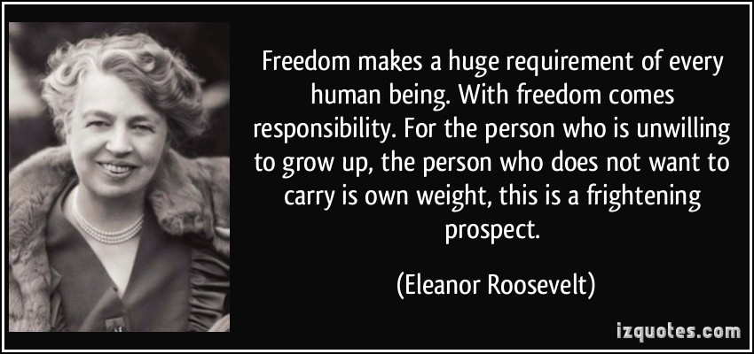
Many of you need to work on this Habit of Mind!
Self-Regulated Learning is a habit of mind that encompasses the desire to learn, the ability to set personal goals for learning, and the capacity to engage in a self-monitored learning process. Self-regulated learners typically demonstrate strong commitment to the process of learning and take responsibility for their own learning. They take intellectual risks, persist in the face of challenges, and learn from their mistakes. They are able to organize and reorganize information, interpret information in new ways, and generate their own ideas. Self-regulated learners demonstrate meta-cognitive awareness (an understanding of the factors that influence their own learning) and cultivate the skills and confidence they need in order to be effective learners.

Slide 12
How to democratically self discipline?
Self-Regulated Learning: setting and sticking to deadlines: Oct 8, 2019 Name: ______________
Many of you have yet to turn in a great deal of classwork. What are you missing?
Assignments so far [30 total points] Put an ‘X’ under your missing work
RA 1:Moodle [5pts] RA2:Impractical [5pts] RA3:UBI [5pts] HoM 1 [5pts] Ecotopia Assn [10pts]
I plan to have this work completed by: __________________ [Thur Oct 17 by 10am latest]

Slide 13

You will receive two small pieces of paper.
On the green one, write only your letter choice for today’s discussion.
On the yellow one, clearly write your first and last name, and today’s date.
A: Watch The Coconut Revolution
B: Read Ecotopia or work on Reading Assignment 3
C: Walk in the woods
D: It doesn’t really matter to me
Tuesday September 24, 2019

Slide 14
Benefits:
More. Enjoyable. And. Memorable.
More responsive to their needs
More responsive to MY needs!
More group solidarity
A live example of utopian thinking
Problems:
Requires more prep
Not as participatory as hoped
Too much freedom?
Less ordered
(missed BWE opportunity)

Slide 15
Thanks!
Please tell me what y’all think!
And importantly…
How to improve this experiment

